Slide 1
AVOCADOS ANALYSIS
Marisol Rodriguez
ENTITY / Woz-U
DSO110 Final Project

Slide 2

CONTENTS
01 Introduction
02 Background
03 Methods
04 Results
05 Conclusion

Slide 3
Drake University
BA International Relations
Masters Clinical Psychology
Employment Hist. - Communications
Marisol Rodriguez
Brownsville, Texas

Slide 4
Avocado Sales in Dallas/Ft. Worth, San Diego, & Buffalo
This presentation will show my exploration into Avocado consumption and production in selected regions and the results of statistical tests.

Slide 5
Variables
This presentation will show my exploration into Avocado consumption and production in selected regions and the results of statistical tests.

Slide 6
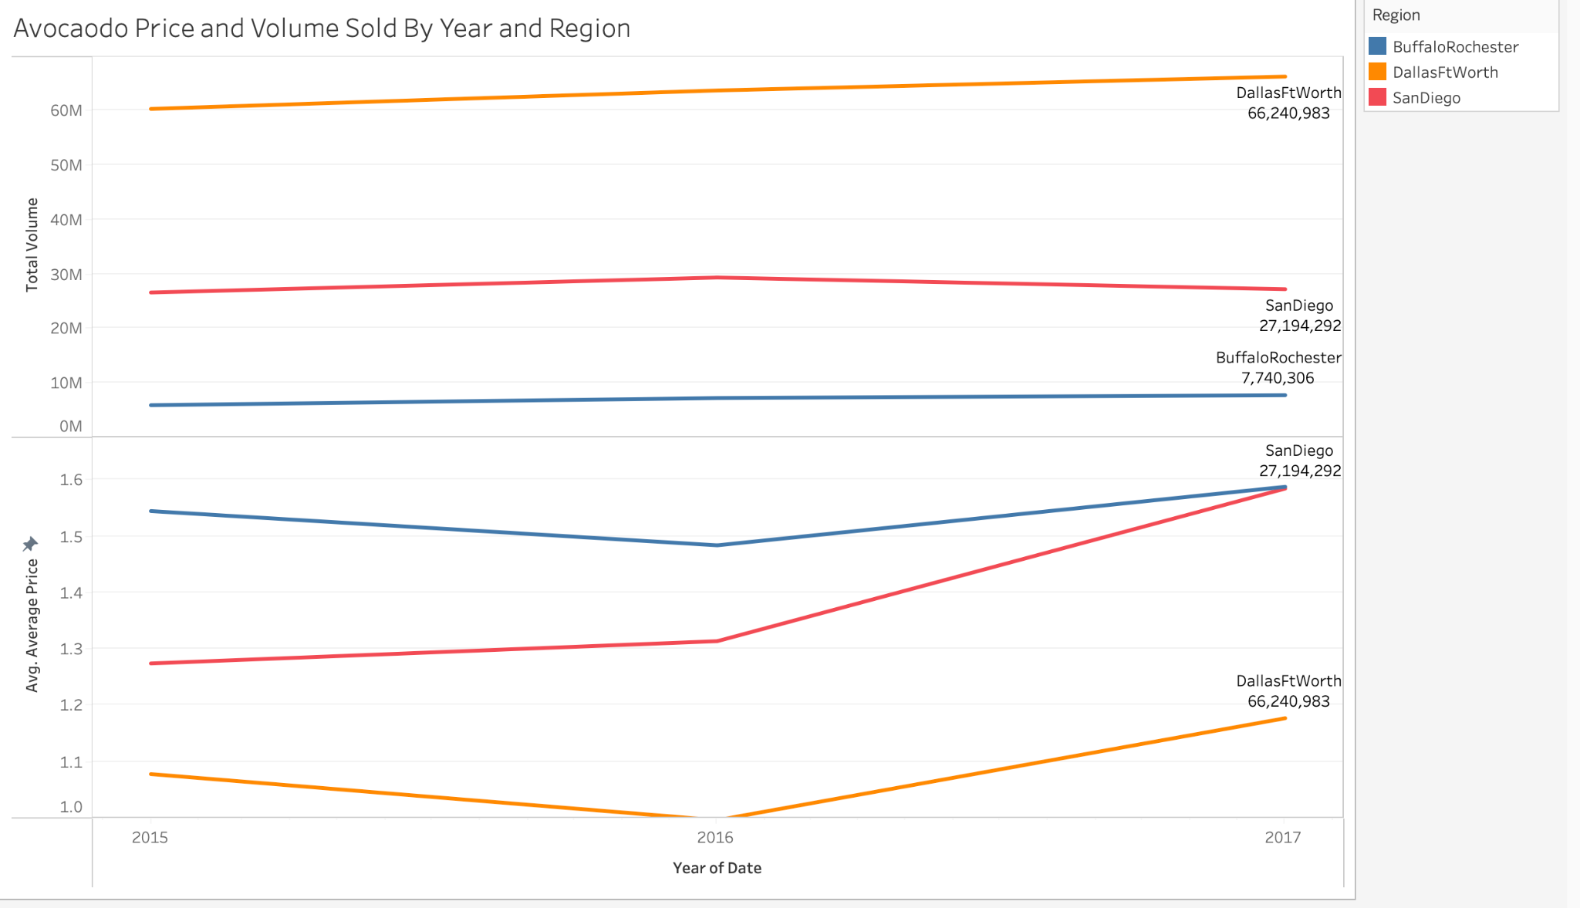
Data Exploration
Notes:
Total Volume did not change much from 2015-2017. Average price increased from 2015-2017 with San Diego being the highest spike. Buffalo had the highest average price around $1.48 and $1.58 per avocado.

Slide 7
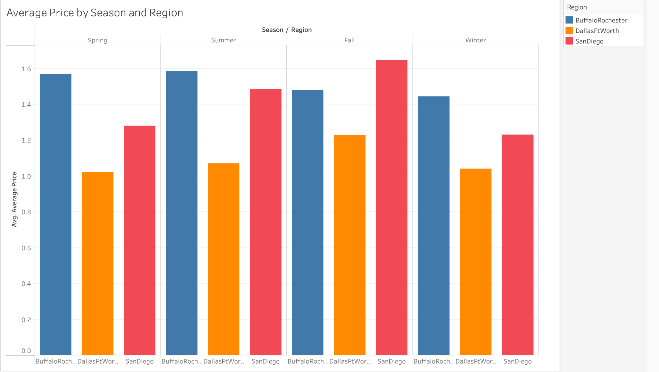
Data Exploration
Notes:
Prices were higher in the Fall for Dallas/Ft. Worth and San Diego. Prices did not change much per season in Buffalo/Rochester area.

Slide 8
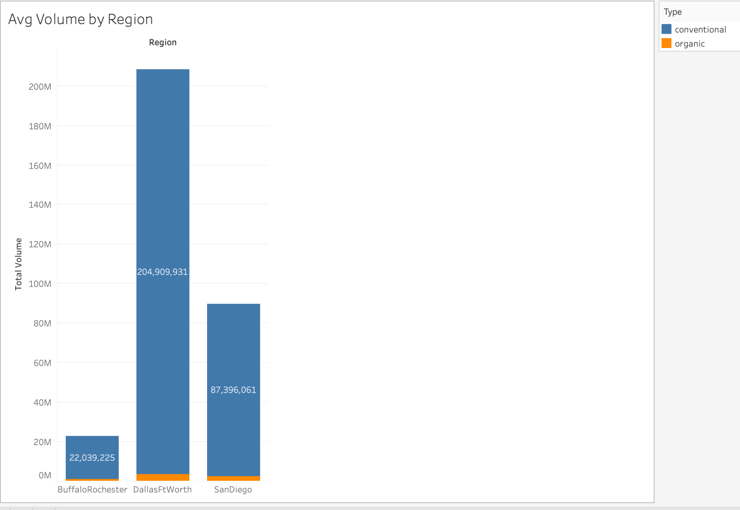
Data Exploration
Notes:
In these areas of Dallas/Ft Worth, Buffalo/Rochester, and San Diego its more conventional than organic. Dallas/Ft Worth region is more organic than the other regions.

Slide 9
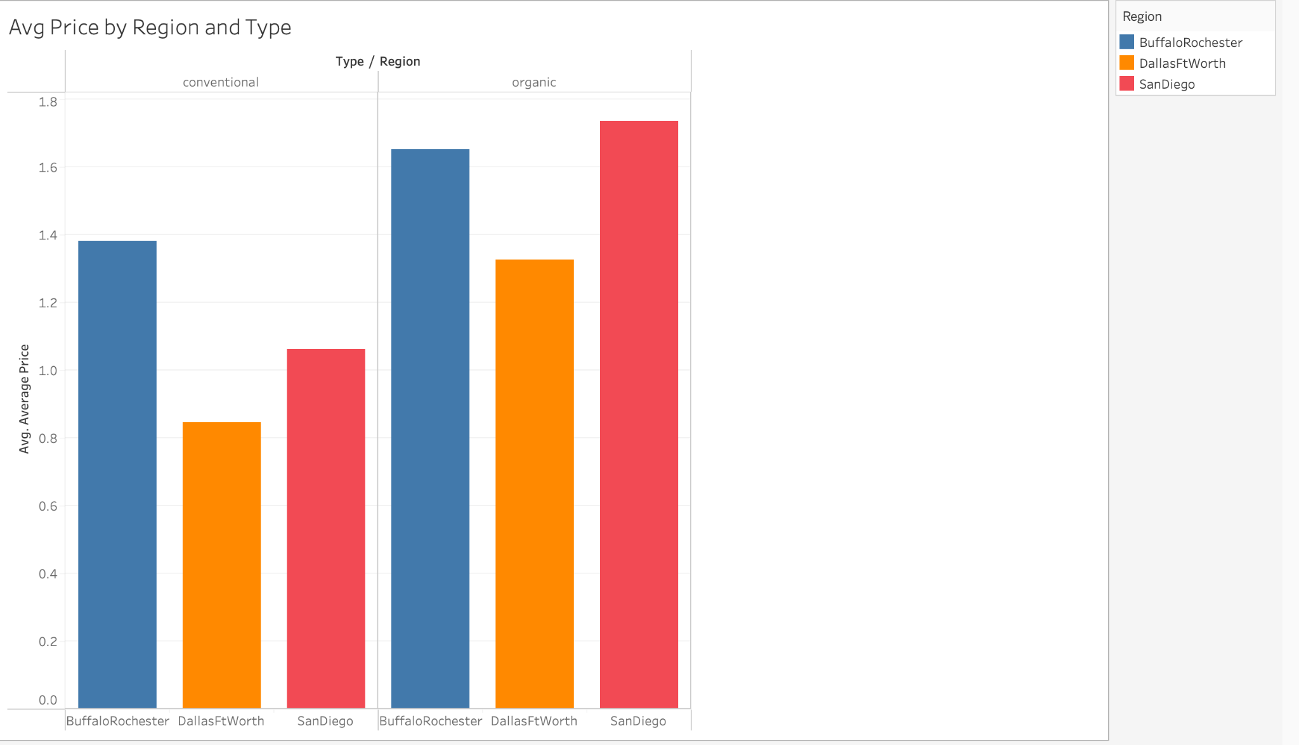
Data Exploration
Notes:
Organic prices are higher in each region. Dallas Ft. had lowest average price and San Diego had highest average price for both types.

Slide 10
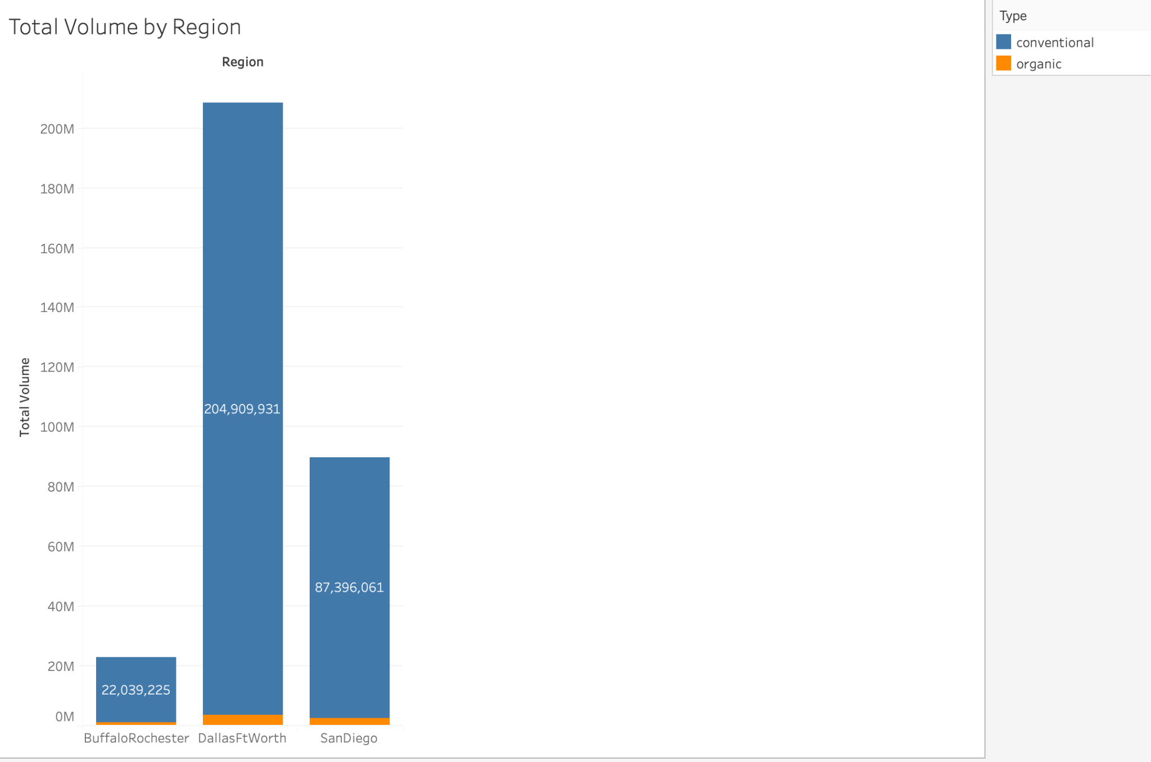
Data Exploration
Notes:
Organic prices are higher in each region. Dallas Ft. had lowest average price and San Diego had highest average price for both types.

Slide 11
Were the average avocado prices different between the regions?
Notes:
We saw the difference of average price per avocado by region, but lets run an ANOVA to be statistically sure.

Slide 12
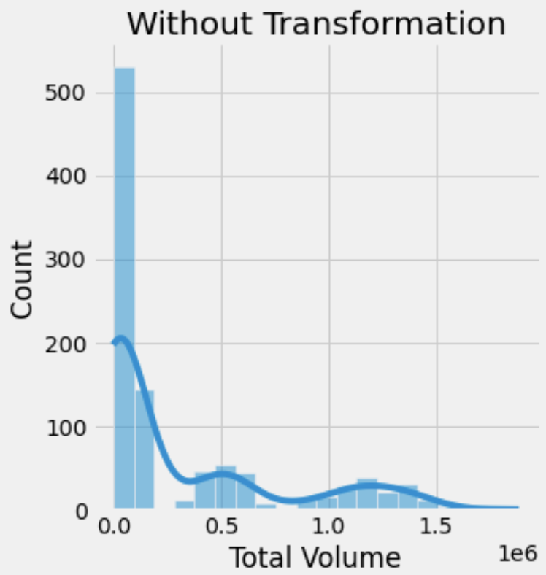
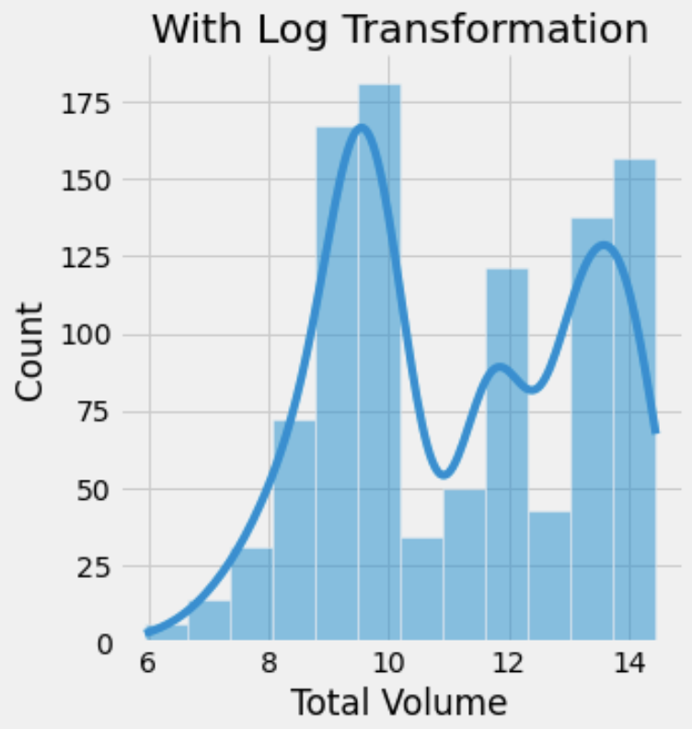
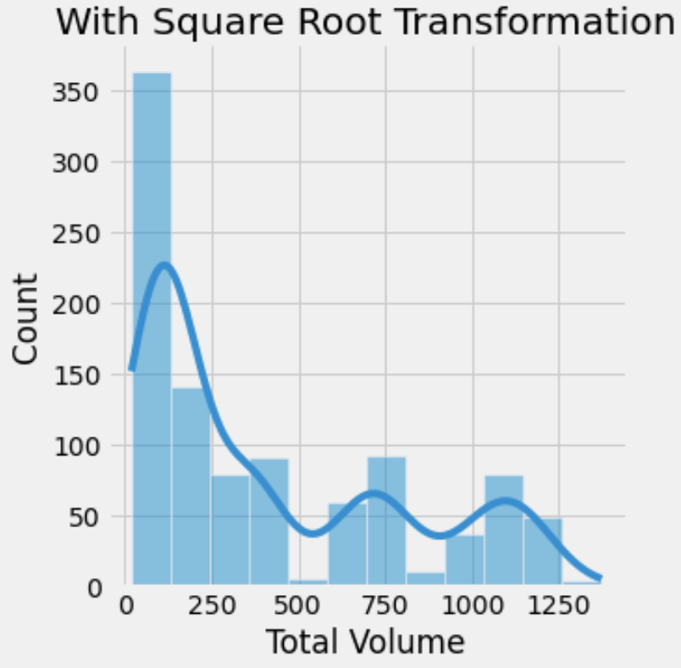
One-Way ANOVA
ANOVA Assumption of Normality
Log Transformation seems to normalize the most.
Notes:
Log transformation seems to normalize the dependent variable the most. Basic one-way ANOVAs can tolerate the violation of normality if there is a large sample size for each group. There is 338 observations per group (region) so we are in the clear..

Slide 13
One-Way ANOVA
ANOVA Assumptions Cont.
Sample size has at least 20 cases per independent variable.
No overlap between groups (regions) and region testings are not related.
Sphericity is not applicable because it’s not a between subjects design
Notes:
\

Slide 14
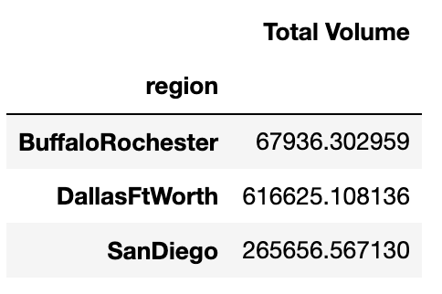
One-Way ANOVA Comparing Region and Volume Sold
ANOVA Results
ANOVA result was significant serving as evidence that there was a difference between average avocado consumption (volume sold) of the three regions
There was also a significant difference in consumption BETWEEN each region
Notes:
The volume was the lowest in Buffalo/Rochester and the most in Dallas/Fort Worth.

Slide 15
THANK YOU

